Slide 1
8.3 Angle Relationships
SPI 6.4.2: I will learn to understand relationships of angles

Slide 2
Congruent angles have the same measure.
Vertical angles are formed opposite each other when two lines intersect. Vertical angles have the same measure, so they are always congruent.
∠MRP and ∠NRQ are vertical angles.
∠MRN and ∠PRQ are vertical angles

Slide 3
Vocabulary
congruent
vertical angles
adjacent angles
complementary angles
supplementary angles

Slide 4
Adjacent angles are side by side and have a common vertex and ray. Adjacent angles may or may not be congruent.
∠MRN and ∠NRQ are adjacent angles. They share vertex R and RN.
∠NRQ and ∠QRP are adjacent angles. They share vertex R and RQ.

Slide 5
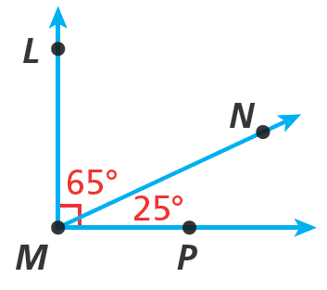
Complementary angles are two angles whose measures have a sum of 90°.
65° + 25° = 90°
∠LMN and ∠NMP are complementary.

Slide 6
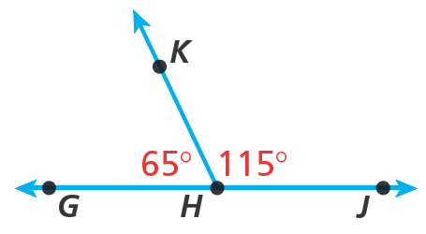
Supplementary angles are two angles whose measures have a sum of 180°.
65° + 115° = 180°
∠GHK and ∠KHJ are supplementary.

Slide 7
Identify the type of each angle pair shown.
5 6
∠5 and ∠6 are opposite each other and are formed by two intersecting lines.
They are vertical angles.

Slide 8
Identify the type of each angle pair shown.
∠7 and ∠8 are side by side and have a common vertex and ray.
7 8
They are adjacent angles.

Slide 9
Find each unknown angle measure.
The angles are complementary.
1
71°

Slide 10
Find each unknown angle measure.
The angles are supplementary.
125°
2

Slide 11
Additional Example 2C: Identifying an Unknown Angle Measure
Find each unknown angle measure.
The angles are vertical angles.
m∠3 = 82°
Vertical angles are congruent.
3
82°

Slide 12
Find each unknown angle measure.
∠JKL and ∠MKN are congruent.
M
L
80°
x
y
J
K
N

Slide 13
Find each unknown angle measure.
The angles are complementary.
d
65°

Slide 14
Find each unknown angle measure.
The angles are supplementary.
145°
s

Slide 15
Find each unknown angle measure.
The angles are vertical angles.
t
32°

Slide 16
Find each unknown angle measure.
∠ABC and ∠DBE are congruent.
C
D
50°
x
y
A
B
E

Slide 17
Lesson Quiz
1. Identify the type of angle pair shown.
Find each unknown angle measure.
2. The angles are vertical angles.
3. The angles are supplementary.
6
7
adjacent
d
d = 130°
130°
x = 45°
x
135°

Slide 18
Lesson Quiz for Student Response Systems
2. Identify the unknown angle measure if the angles are complementary.
A. 40°
B. 50°
C. 90°
D. 140°
A
40°

Slide 19
Lesson Quiz for Student Response Systems
3. Identify the unknown angle measure if the angles are supplementary.
A. y = 145°
B. y = 125°
C. y = 90°
D. y = 35°
A
55°

