Slide 1
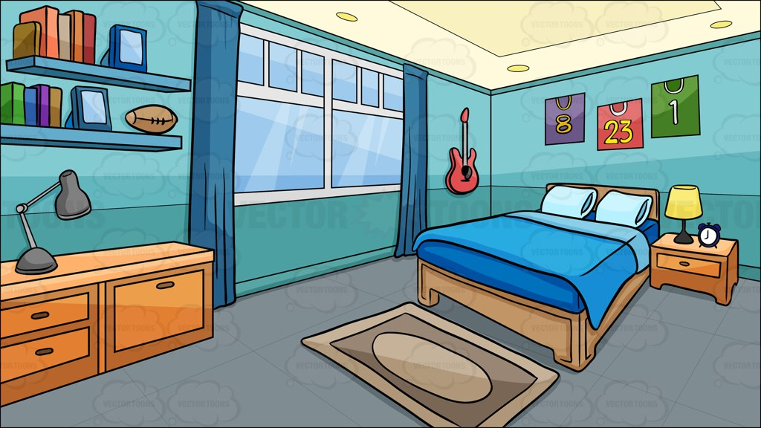
Mr. Lawson’s Dream Room project

Slide 2
Objective
The objective for this project is to spend $10,000 to create your dream room. You must spend as much of the money as possible on at least 8 items for your room without going over the $10,000 budget. Each item will have either a discount percentage of 40%, 30%, 20% or 10%.

Slide 3
Vocabulary
Sales Tax –
Sales Price -
Subtotal –
Discount –
Original Price –
Budget -

Slide 4
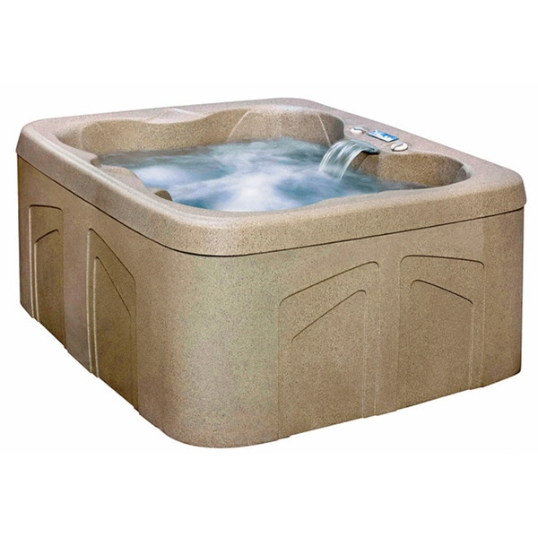
1.) Spa with 13 Jets
Original Price - $2,778.49
Discount Percentage - 40%
Steps:
1.) 40% = 0.40
2.) $2,778.49 x 0.40 = $1,111.40
3.) $2,778.49 - $1,111.40 = $1,667.09
Discount Price - $1,111.40
Sales Price - $1,667.09

Slide 5
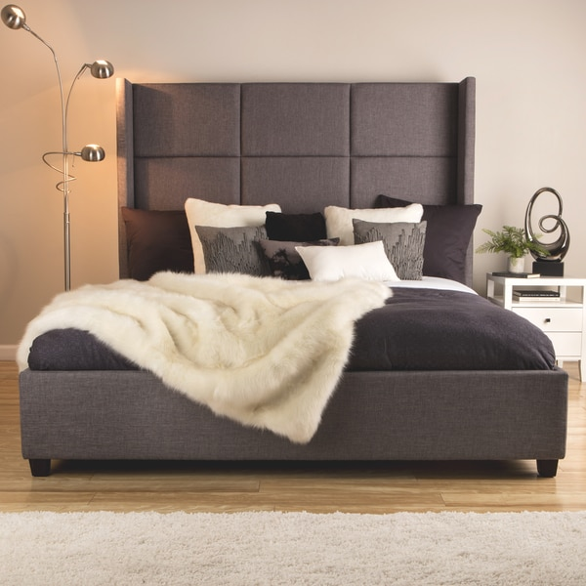
2.) Jillian Upholstered King-size Bed
Original Price - $749.99
Discount Percentage - 40%
Steps:
1.) 40% = 0.40
2.) $749.99 x 0.40 = $300.00
3.) $749.99 - $300.00 = $449.99
Discount Price - $300.00
Sales Price - $449.99

Slide 6
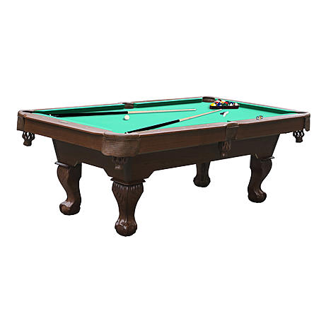
3.) 90" Billiard Pool Table
Original Price - $512.99
Discount Percentage - 30%
Steps:
1.) 30% = 0.30
2.) $512.99 x 0.30 = $153.90
3.) $512.99 - $153.90 = $359.09
Discount Price - $153.90
Sales Price - $359.09

Slide 7
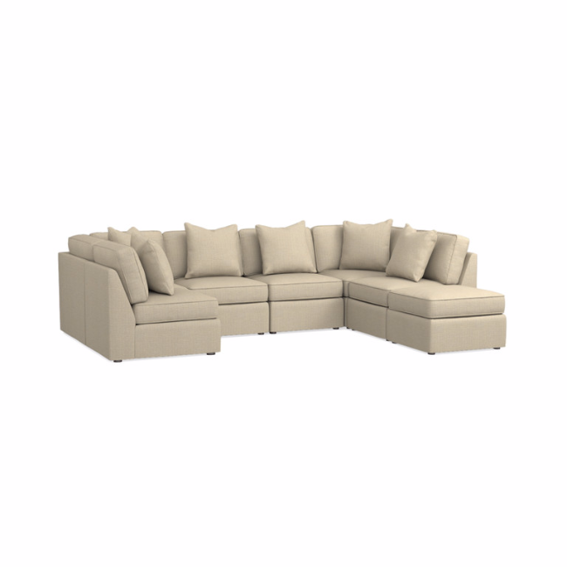
4.) Beckie U-Shaped Sectional
Original Price - $3,547.00
Discount Percentage - 30%
Steps:
1.) 30% = 0.30
2.) $3,547.00 x 0.30 = $1,064.10
3.) $3,547.00 - $1,064.10 = $2,482.90
Discount Price - $1,064.10
Sales Price - $2,482.90

Slide 8
5.) Wall Fish Tank Aquarium
Original Price - $549.00
Discount Percentage - 20%
Steps:
1.) 20% = 0.20
2.) $549.00 x 0.20 = $109.80
3.) $549.00 - $109.80 = $439.20
Discount Price - $109.80
Sales Price - $439.20

Slide 9
Sales Tax (8%)
Sales Tax Calculation
1.) 8% = 0.08
2.) 5,398.27 x 0.08 = $431.86
3.) 5,398.27 + $431.86 = $5,830.13
Sales Tax = $431.86
Final Price = $5,830.13
$2,482.90
$1,667.09
$449.99
$439.20
+_____
$359.09
Subtotals : $5,398.27

Slide 10
$10,000.00 - $ 5,830.13 ___________
BUDGET
Money Left Over = +$4,169.87

